Slide 1

3D Delaunay Triangulation
on GPU
Final Projection - EEC 289Q (Winter 2018)
^{By: Ahmed Mahmoud}
^{Muhammad Awad}

Slide 2
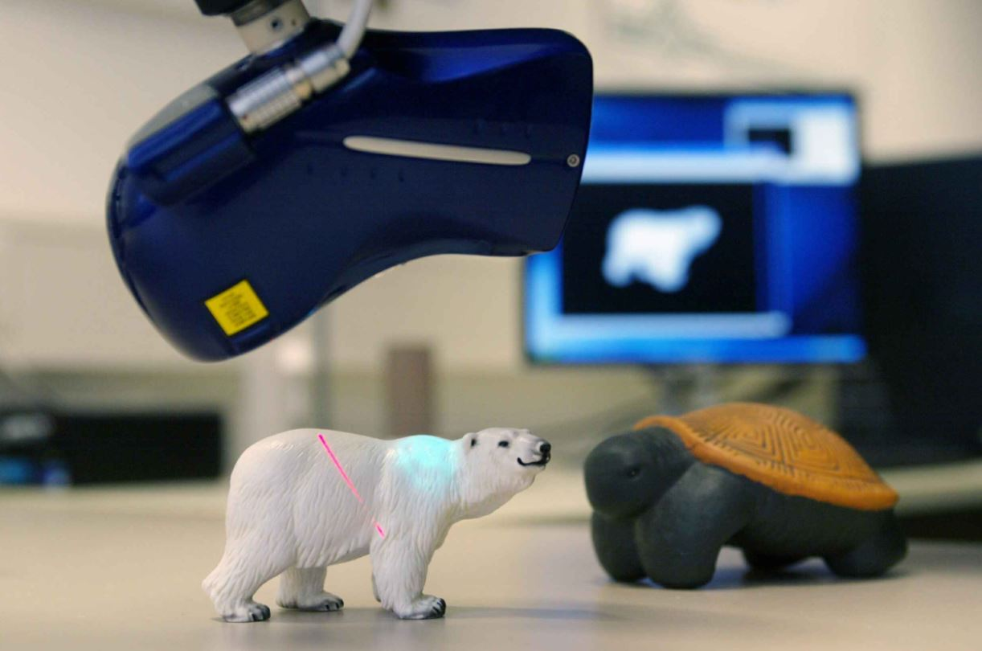
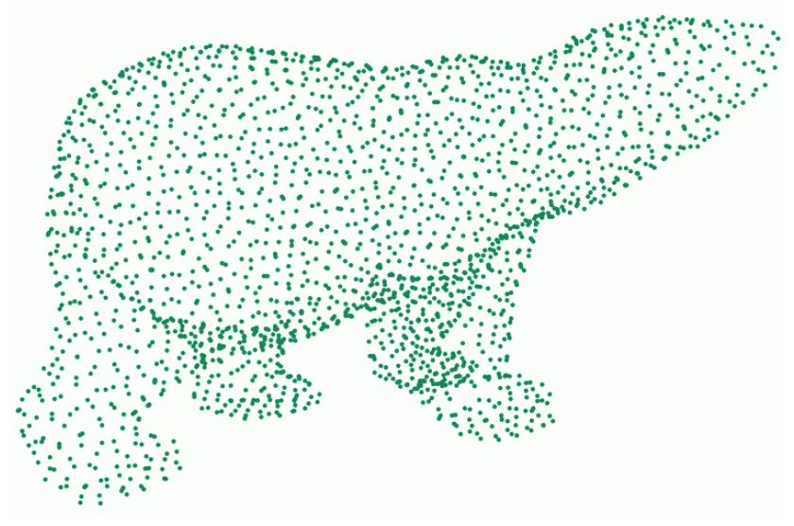
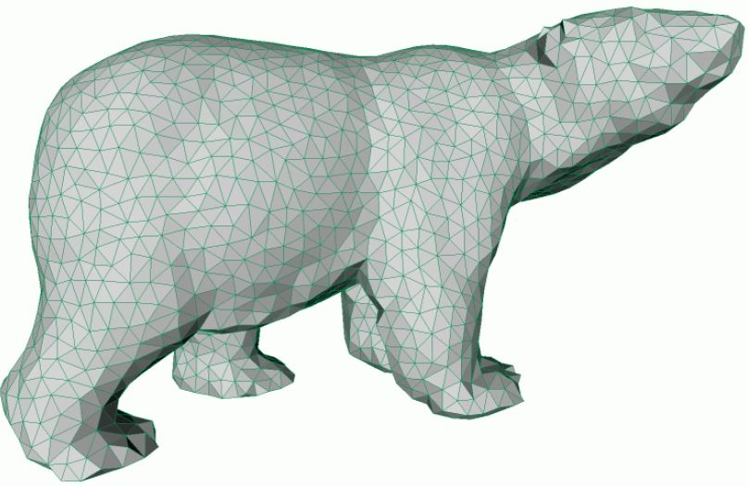
Problem Definition
Scan
Samples
Triangulate
Credits: Geometry Processing - Kai Hormann -2015

Slide 3
Problem Definition
Cloth Simulation
Fluid Simulation
Shape Deformation
Credits: libigl, Robert Bridson

Slide 4
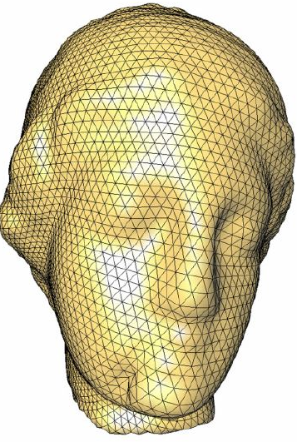
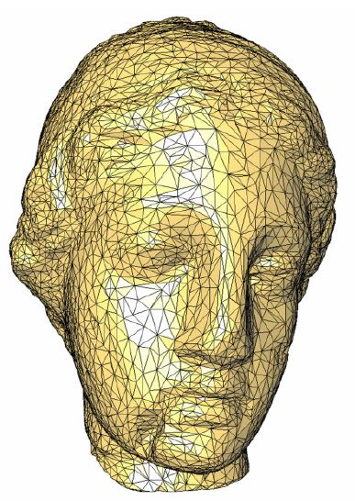

Problem Definition
Physics needs well-shaped triangles
Delaunay gives well-shaped triangles
Credits: Geometric Modeling Based on Polygonal Meshes

Slide 5
Problem Definition
Delaunay = Empty circumcircles
Circumcircles
2D
Samples

Slide 6
Problem Definition
Delaunay = Empty circumcircles
3D
Circumsphere
Tetrahedron
Samples

Slide 7
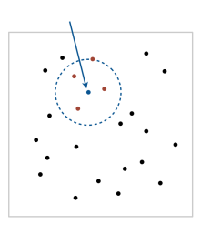
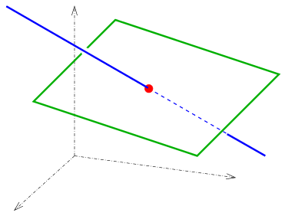
Approach
Building Blocks:
- Range search
- Simple plane-line trimming
Sample
range
3D plane
line

Slide 8
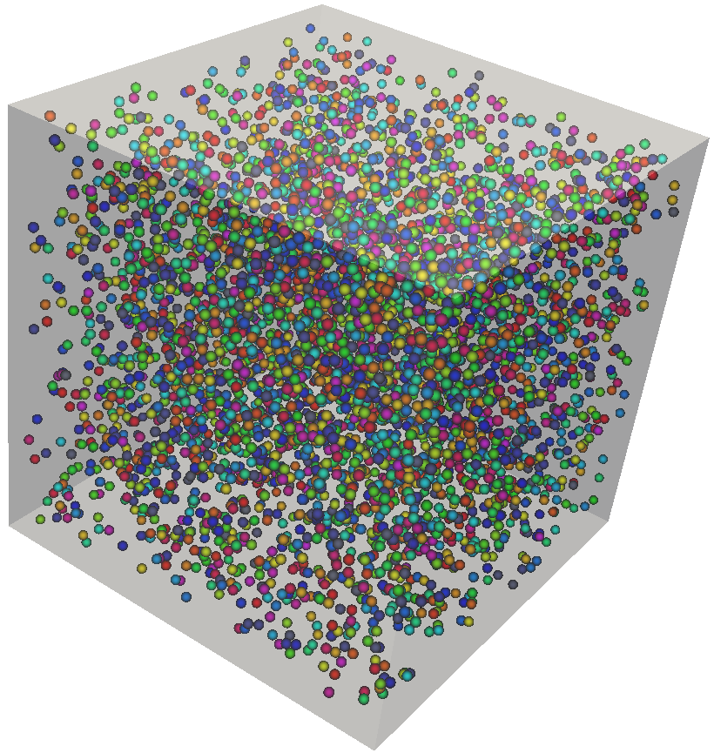
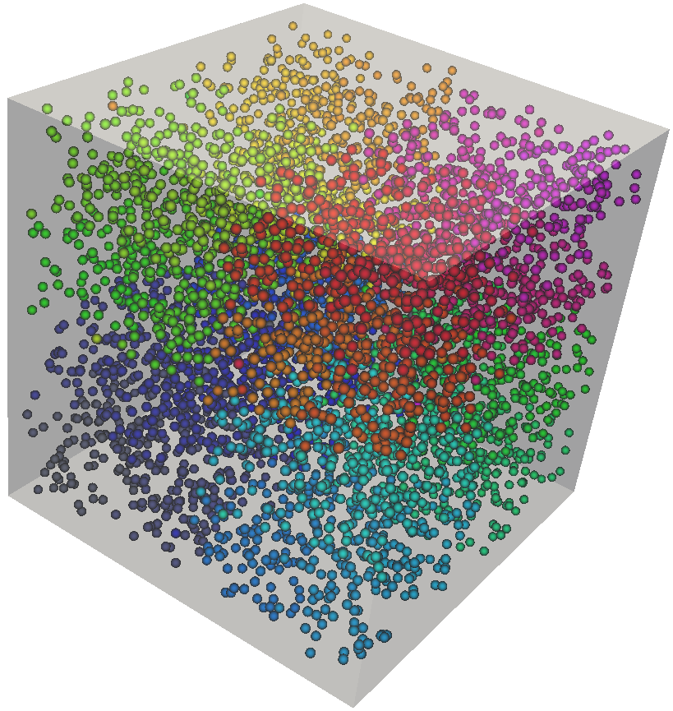
Optimization Choice: Memory Layout
Challenges
Input
Strongly Balanced k-d Tree
Output (Kernel Input)

Slide 9

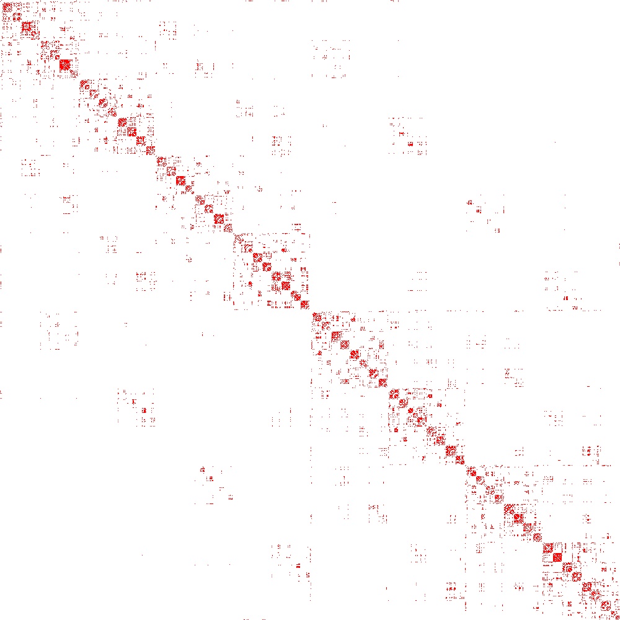
Optimization Choice: Memory Layout
Challenges
Input
Output (Kernel Input)
Strongly Balanced k-d Tree
Adjacency Matrices

Slide 10
Optimization Choice: Memory Layout
Challenges
Input
Output (Kernel Input)
Strongly Balanced k-d Tree
Adjacency Matrices

Slide 11
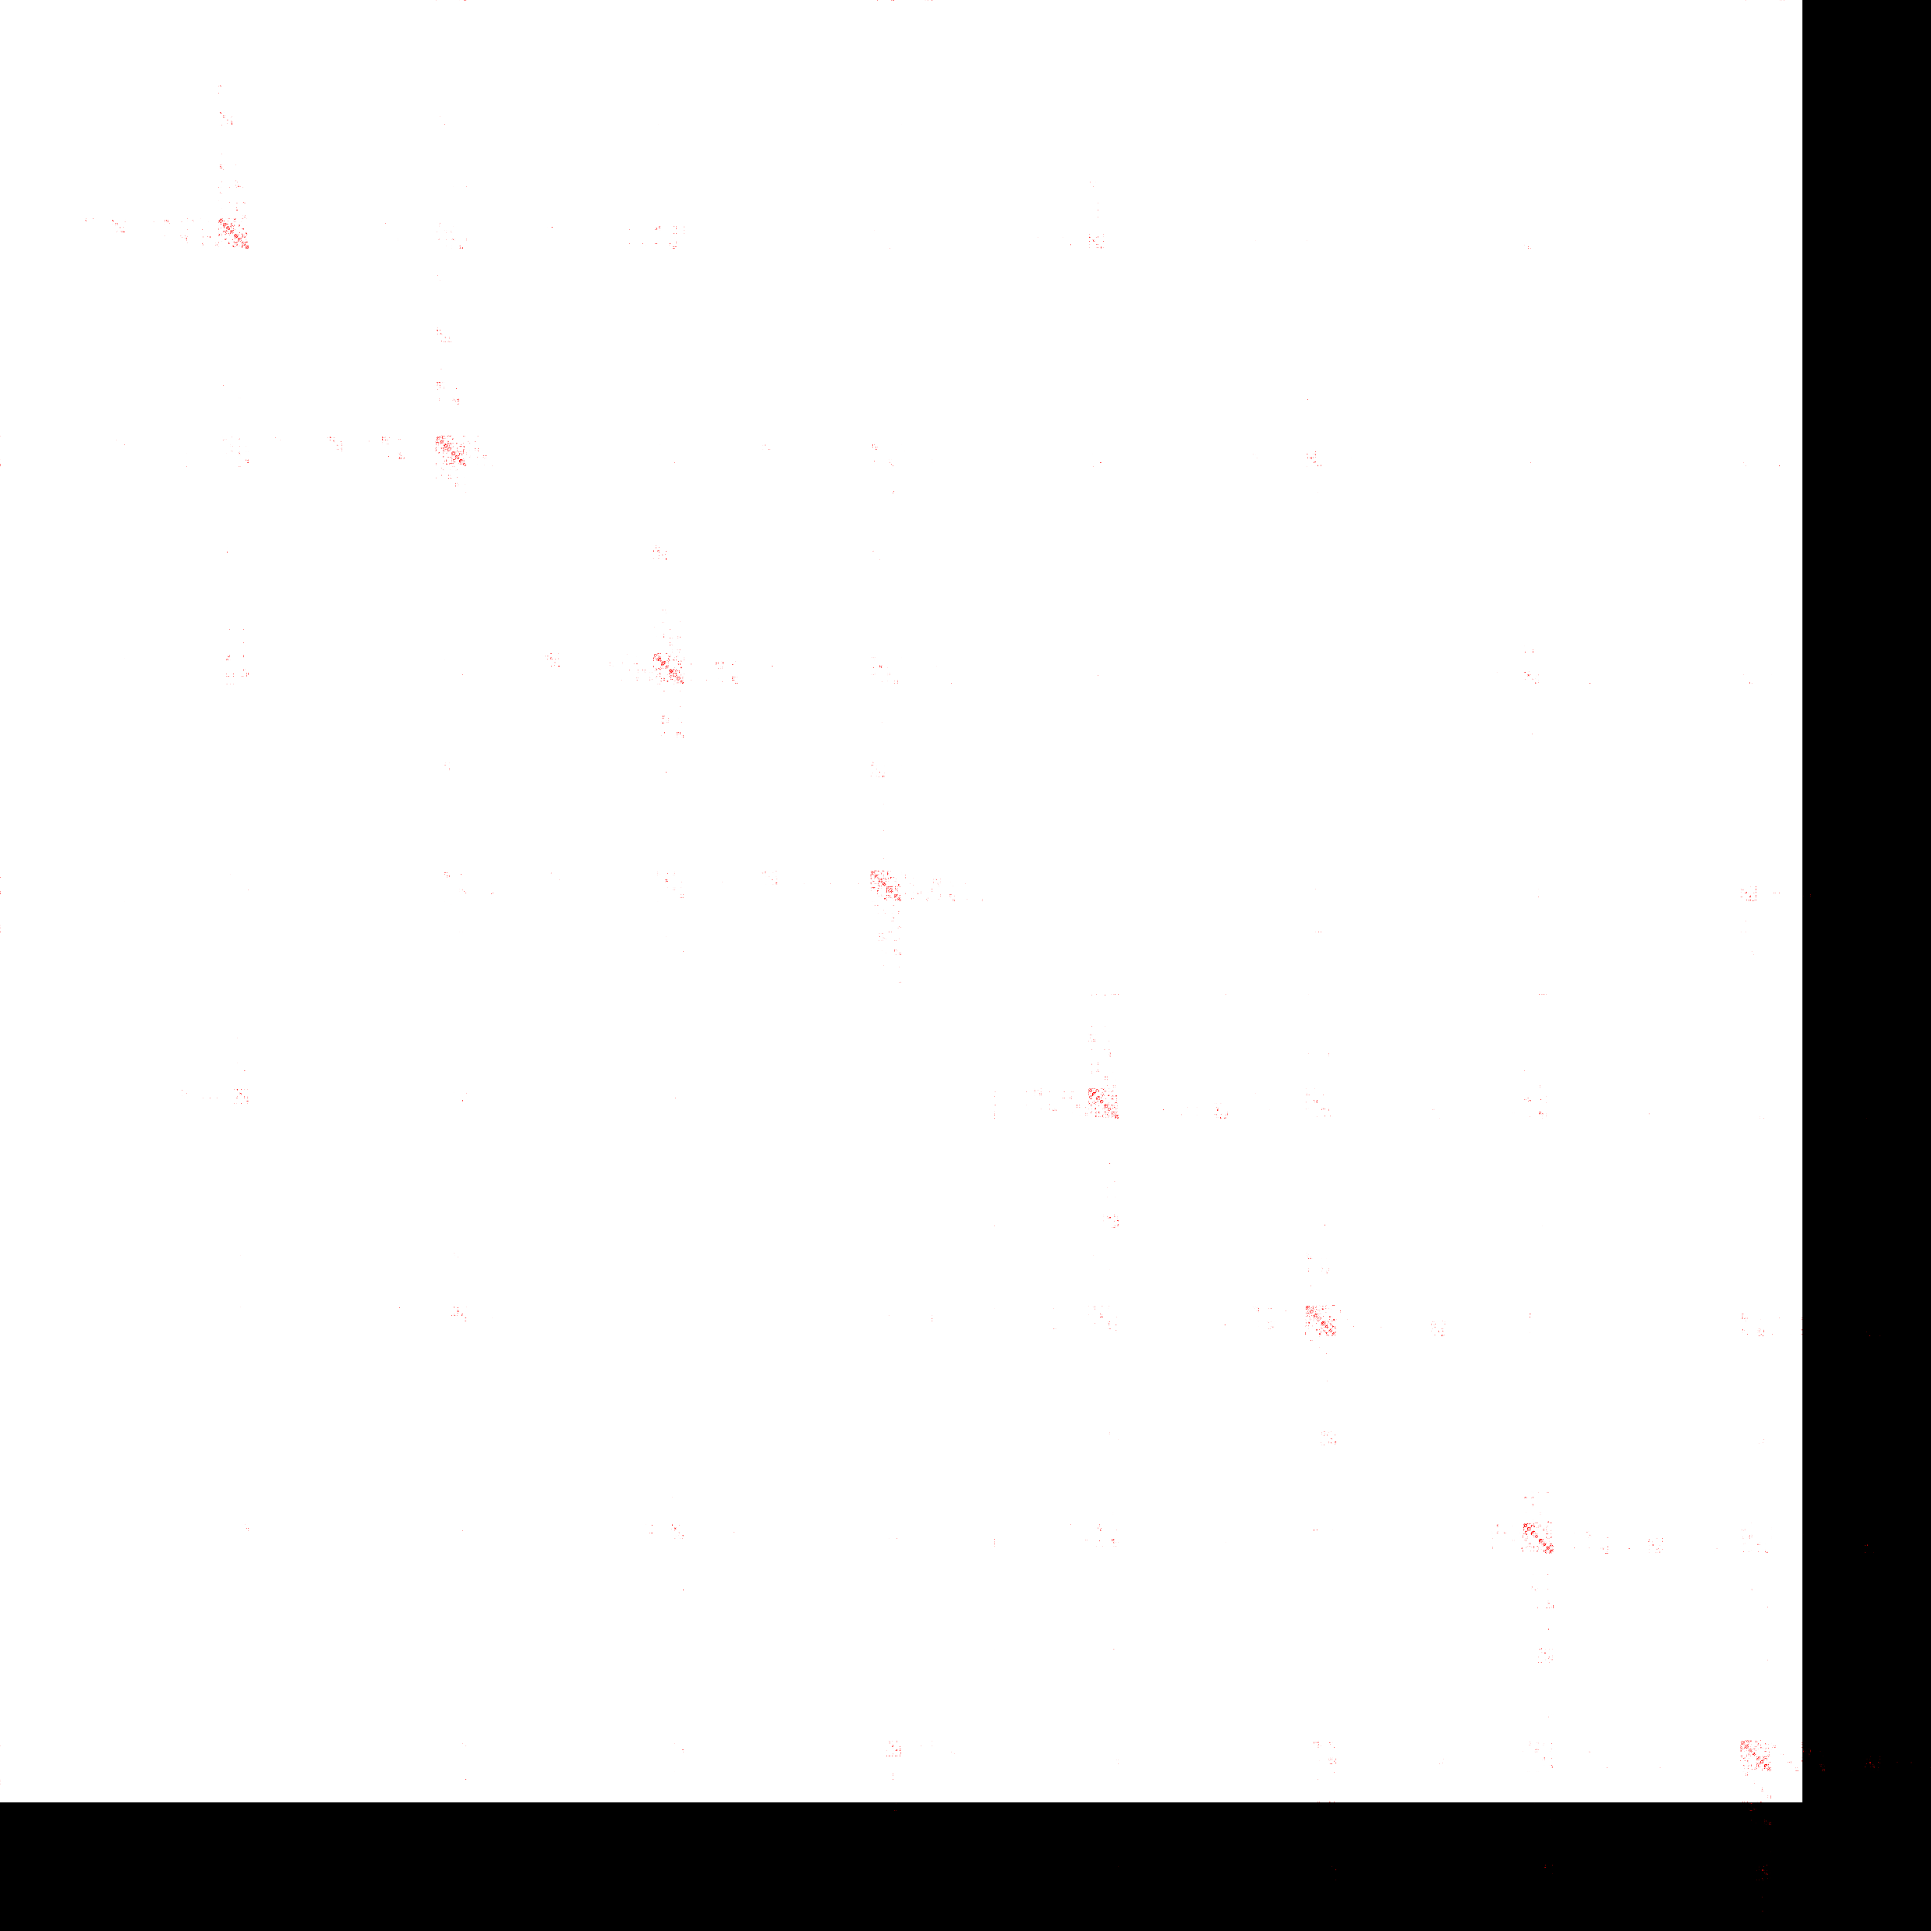
Optimization Choice: Memory Layout
Challenges
Kernel Input
Strongly Balanced k-d Tree
Output
Delaunay Connectivity
Output
Adjacency Matrices

Slide 12
Optimization Choice: Memory Layout
Challenges
Kernel Input
Strongly Balanced k-d Tree
Output
Delaunay Connectivity
Output
Adjacency Matrices

Slide 13
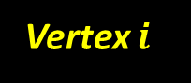
Challenges
Required Work per One Vertex
Number of neighbors is different for each vertex
Filtered
Vertex $i$
Kernel Input
Strongly Balanced k-d Tree
Output
Delaunay Connectivity
Output
Adjacency Matrices

Slide 14
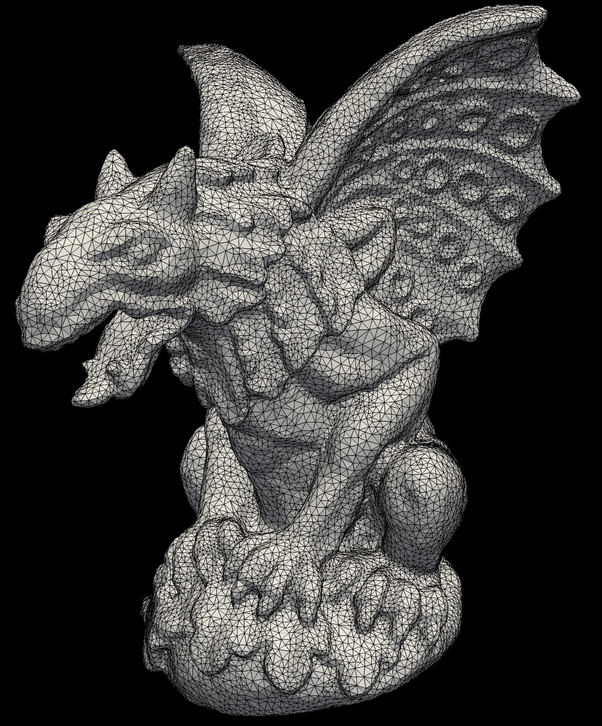
Thank You!

Slide 15
Extra Slides
Bowyer-Watson algorithm
Credits: https://imgur.com/gallery/fDRorkf

Slide 16
Extra Slides
Fortune’s Line Sweep algorithm
Credits: https://github.com/miyu/voronoi

